Slide 1
Mathematical Expectation
Md. Shahidul Salim
Lecturer, CSE,KUET

Slide 2


Mean of a Random Variable
If two coins are tossed 16 times and X is the number of heads that occur per toss, then the values of X are 0, 1, and 2. Suppose that the experiment yields no heads, one head, and two heads a total of 4, 7, and 5 times, respectively. The average number of heads per toss of the two coins is then
This is an average value of the data and yet it is not a possible outcome of {0, 1, 2}. 4/16, or 1/4, of the tosses result in no heads, 7/16 of the tosses result in one head, and 5/16 of the tosses result in two heads, the mean number of heads per toss would be 1.06 no matter whether the total number of tosses were 16, 1000, or even 10,000.

Slide 3
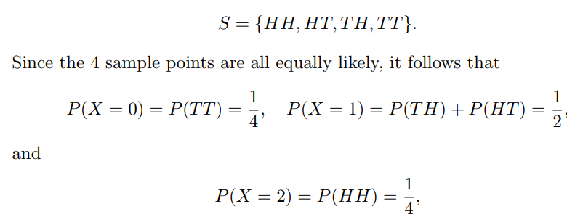

This average value as the mean of the random variable X or the mean of the probability distribution of X and write it as μ_{x} or simply as μ
Refer to this mean as the mathematical expectation, or the expected value of the random variable X, and denote it as E(X)
Assuming that 1 fair coin was tossed twice, we find that the sample space for our experiment is
This result means that a person who tosses 2 coins over and over again will, on the average, get 1 head per toss.

Slide 4
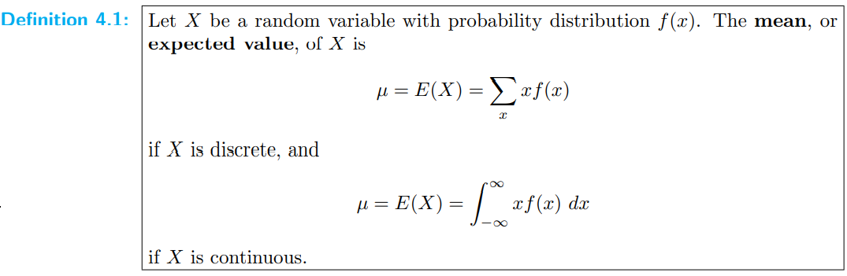

Slide 5
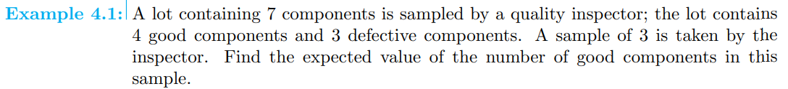
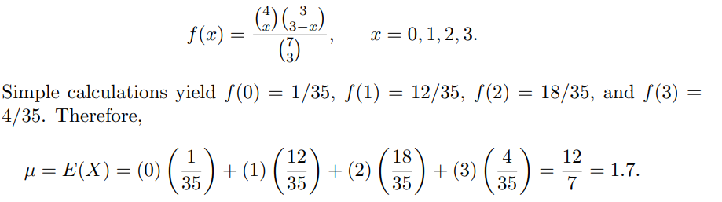

Slide 6
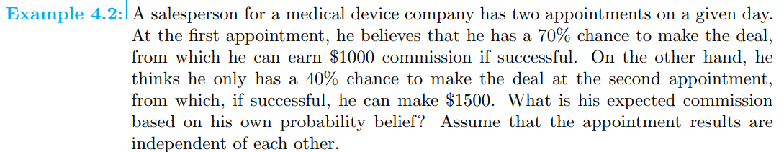
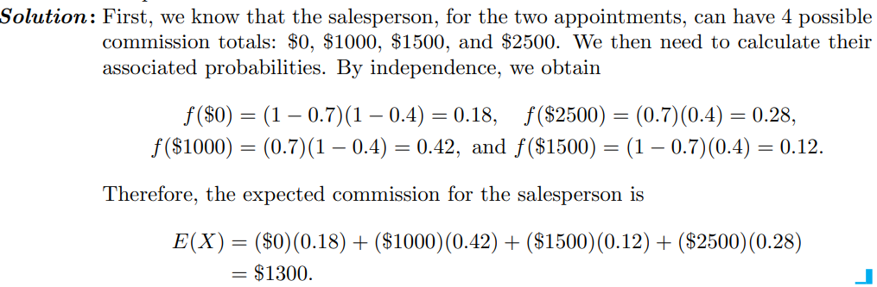

Slide 7
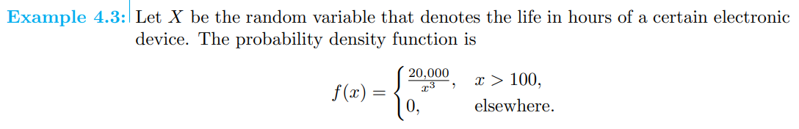
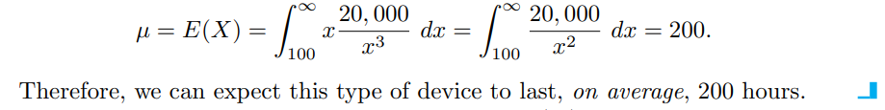

Slide 8
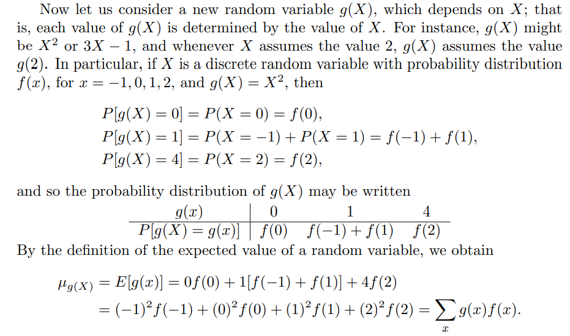

Slide 9
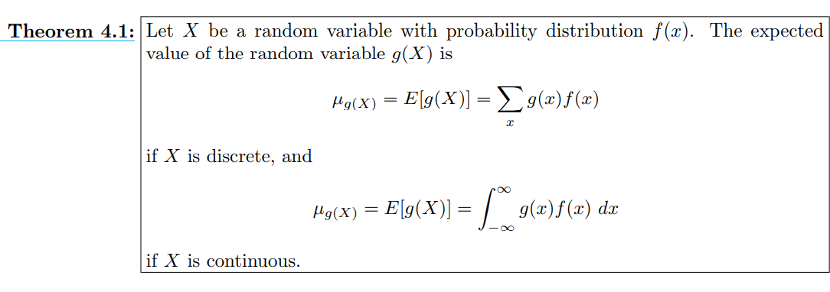

Slide 10
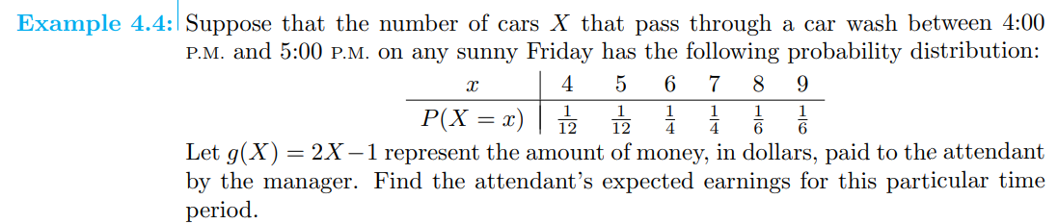
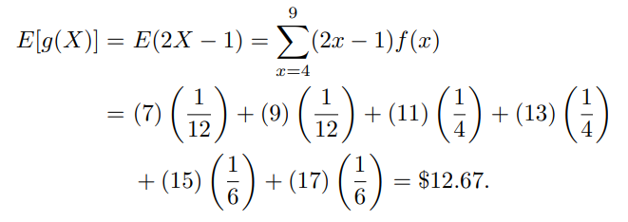

Slide 11
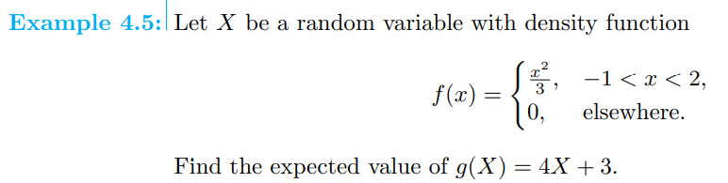
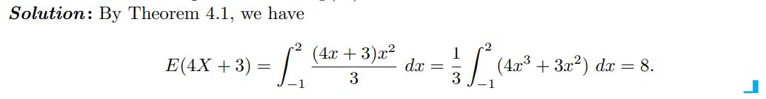

Slide 12
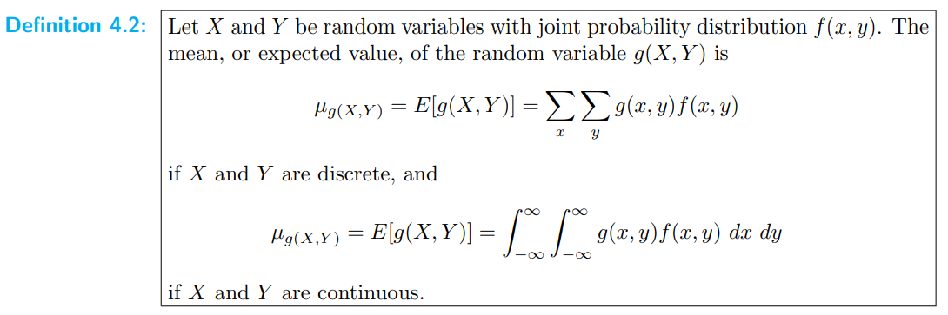

Slide 13
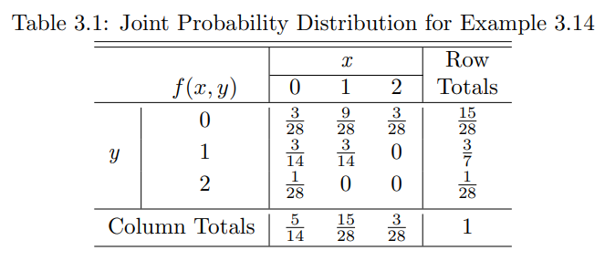
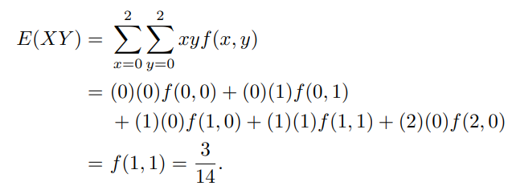
Let X and Y be the random variables with joint probability distribution indicated in Table 3.1 on page 96. Find the expected value of g(X, Y ) = XY . The table is reprinted here for convenience.

Slide 14
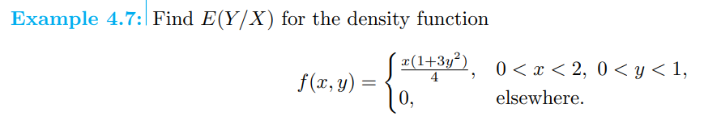
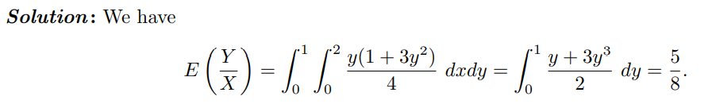

Slide 15
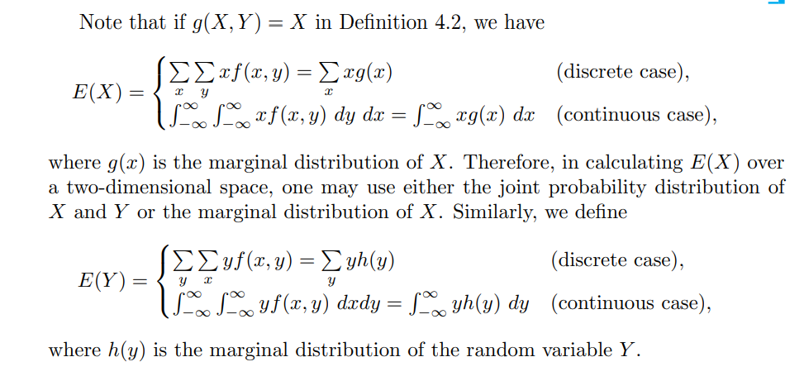

Slide 16
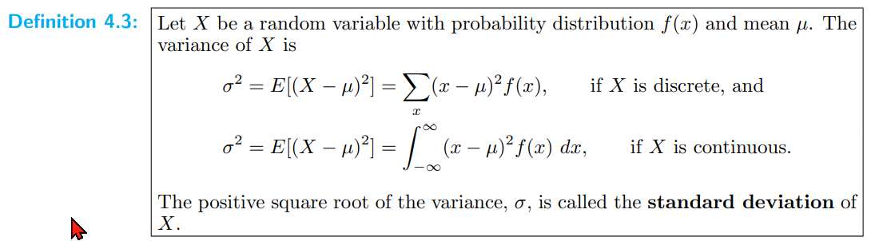
Variance and Covariance of Random Variables

Slide 17
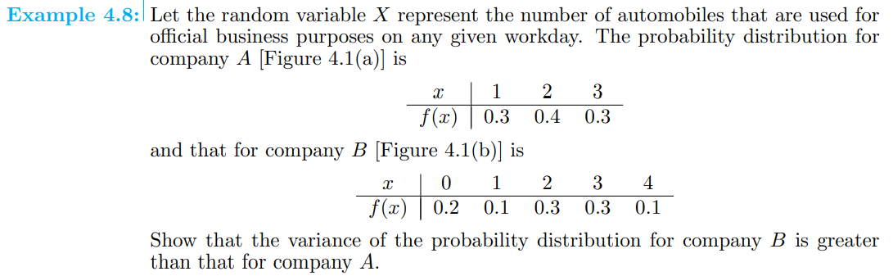
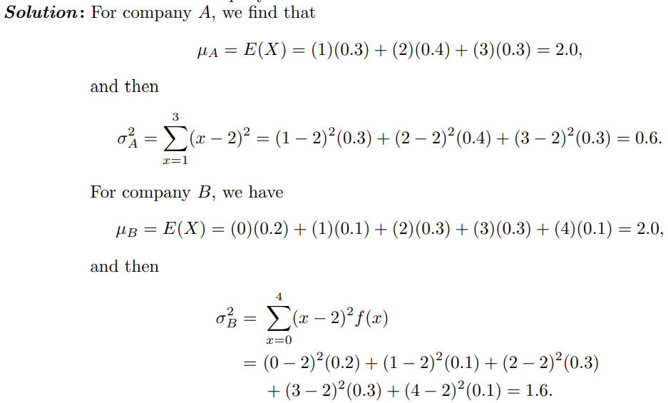

Slide 18
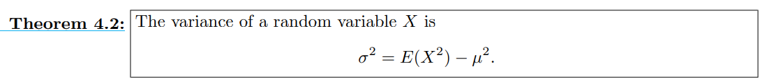
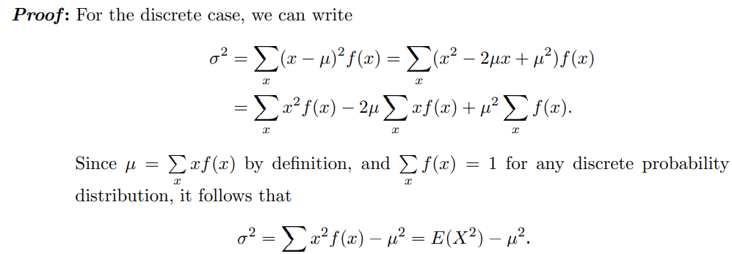

Slide 19
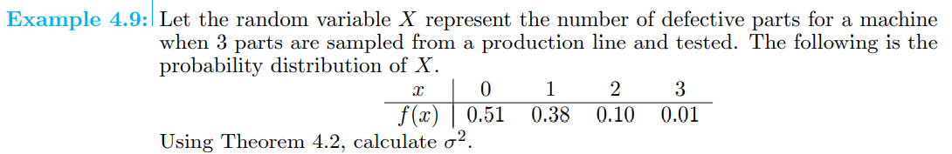
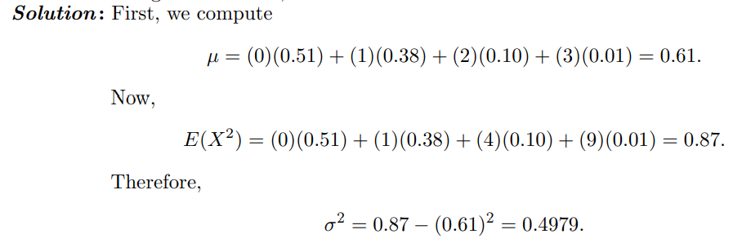

Slide 20
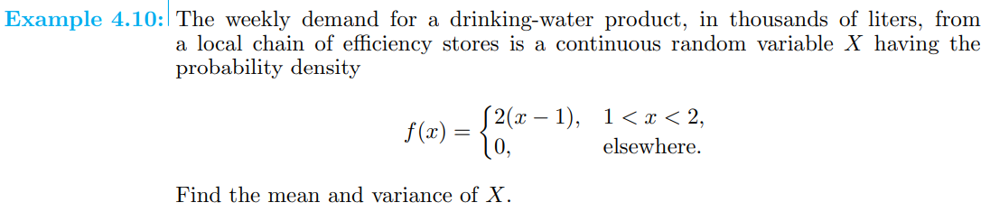
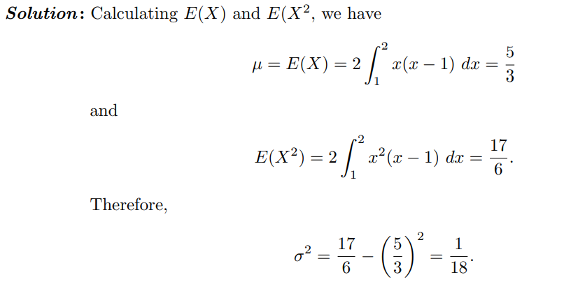

Slide 21
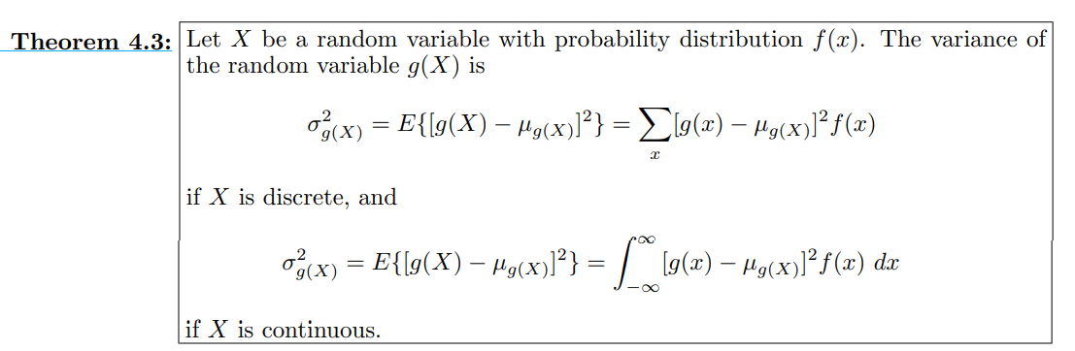

For the random variable g(X), the variance is denoted by σ² _{g(X)} and is calculated by means of the following theorem:

Slide 22
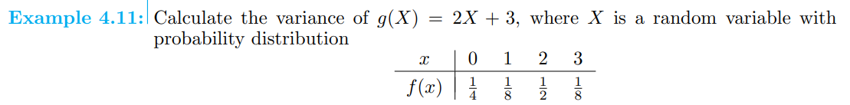
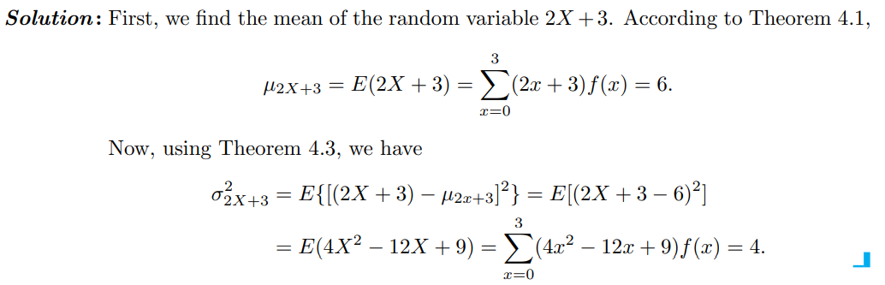

Slide 23
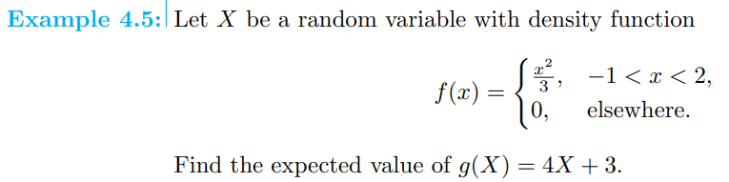
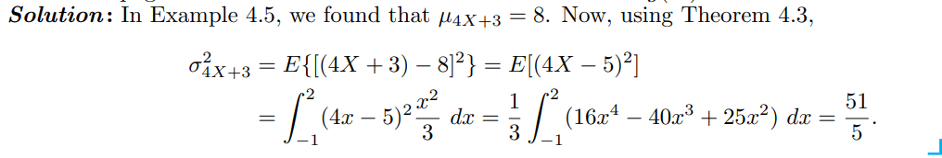

Slide 24

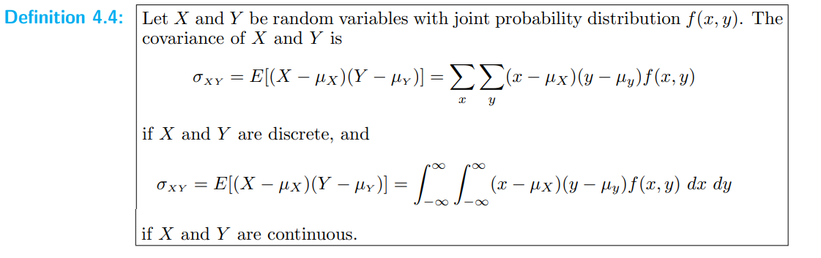

Slide 25
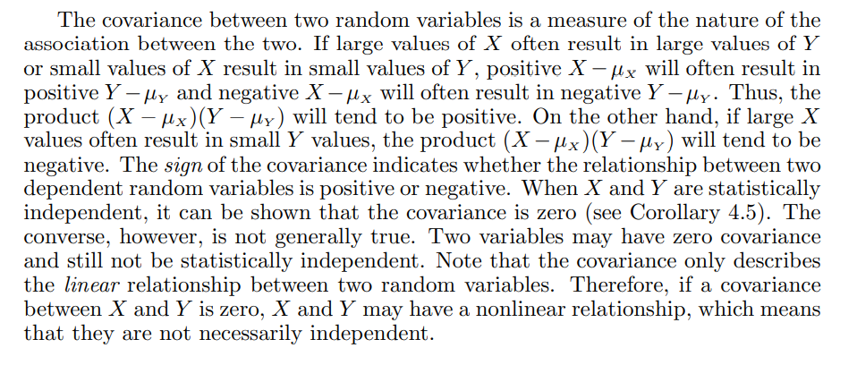

Slide 26
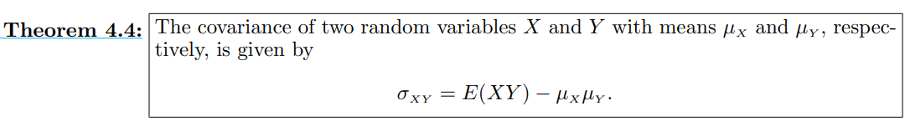
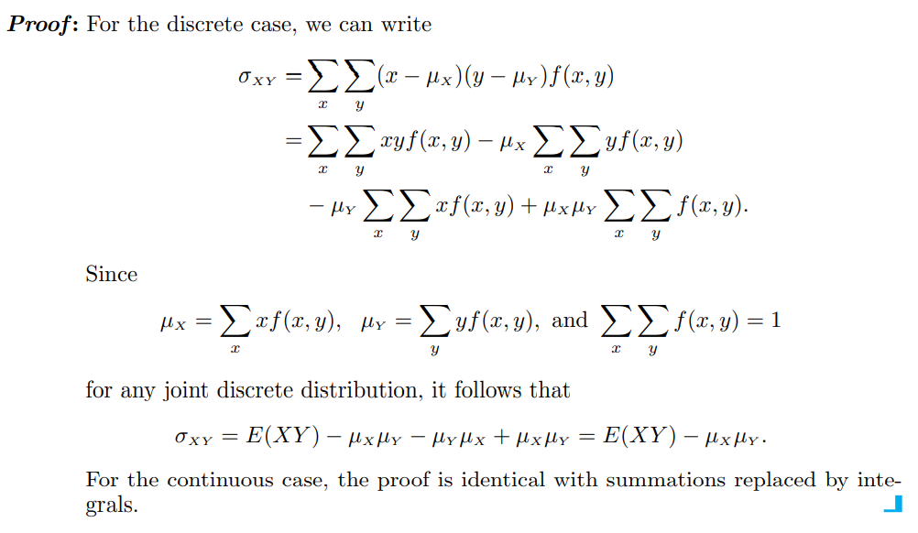

Slide 27
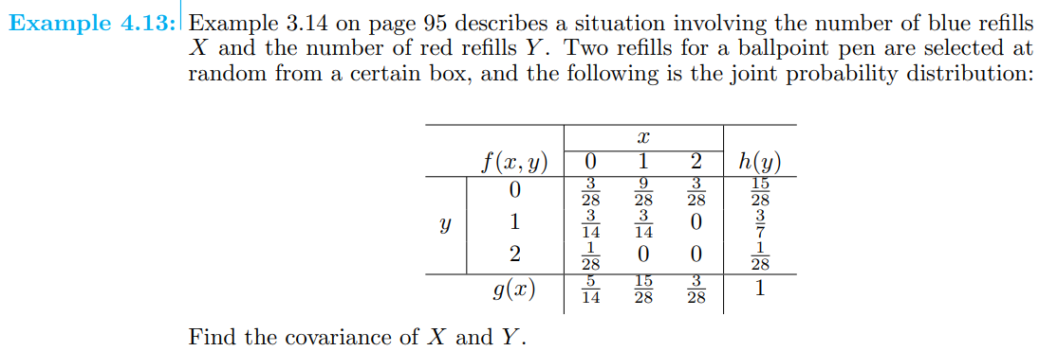
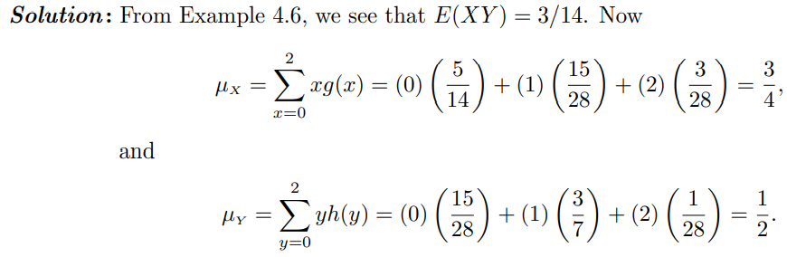


Slide 28
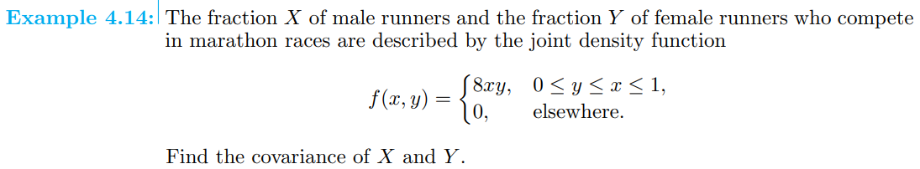
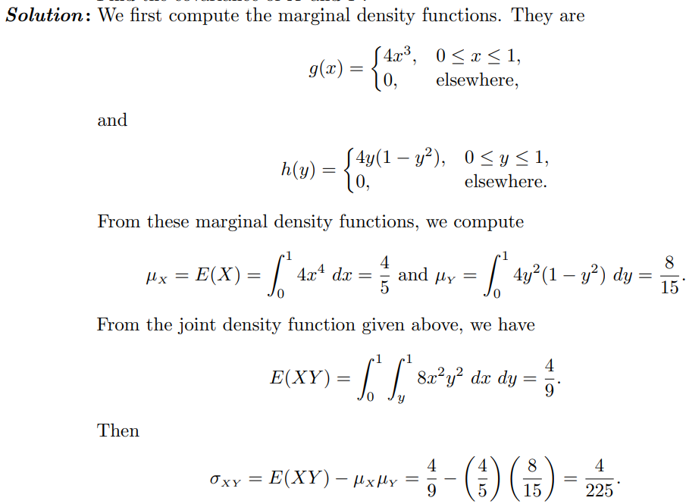

Slide 29
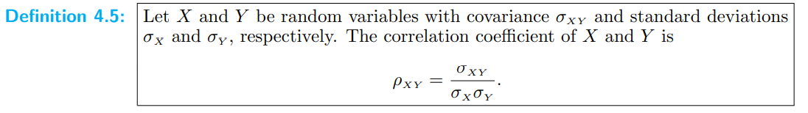
Although the covariance between two random variables does provide information regarding the nature of the relationship, the magnitude of σ_{XY} does not indicate anything regarding the strength of the relationship, since σ_{XY} is not scale-free. Its magnitude will depend on the units used to measure both X and Y . There is a scale-free version of the covariance called the correlation coefficient that is used widely in statistics.
It should be clear to the reader that ρ_{XY} is free of the units of X and Y . The correlation coefficient satisfies the inequality −1 ≤ ρ_{XY} ≤ 1.

Slide 30
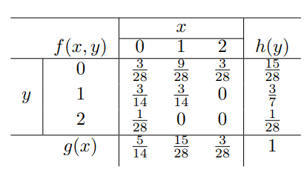
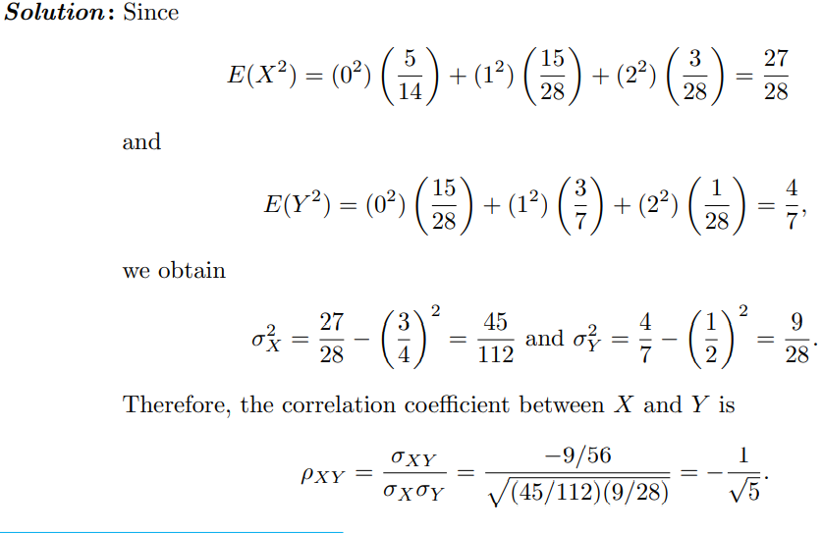
Find the correlation coefficient between X and Y in Example 4.13.

Slide 31
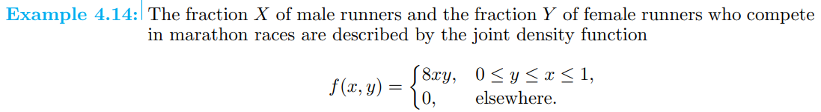

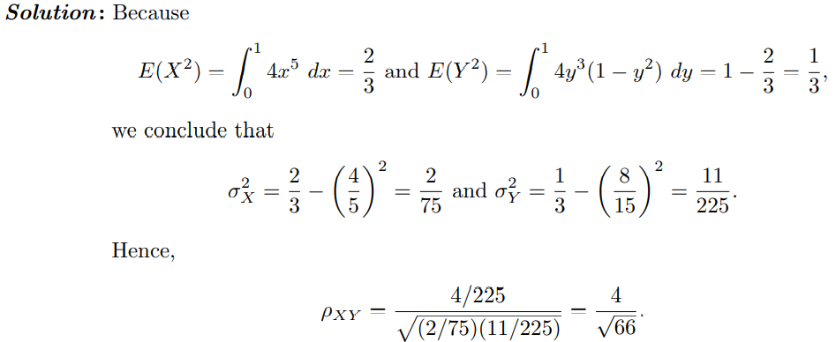

Slide 32
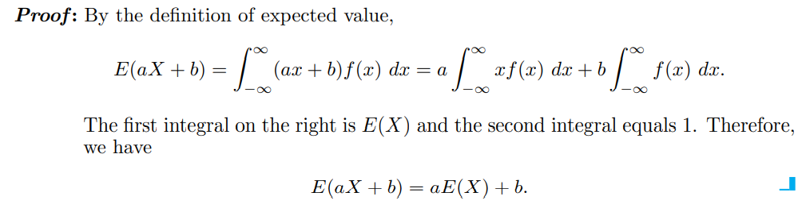
Means and variances of Linear combinations of random variables
If a and b are constants, then E(aX + b) = aE(X) + b.

Slide 33

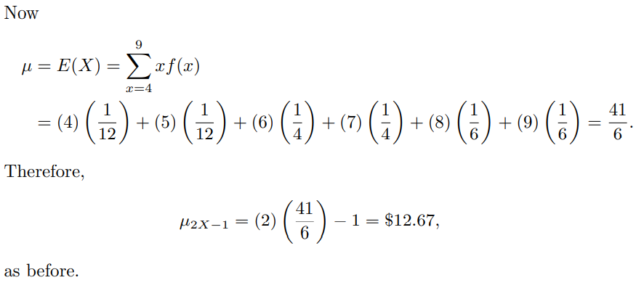
Means and variances of Linear combinations of random variables

Slide 34
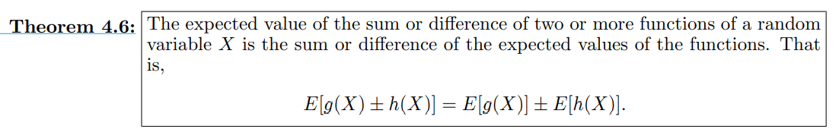


Slide 35



Slide 36



Slide 37




Slide 38


Chebyshev’s Theorem
For k = 2, the theorem states that the random variable X has a probability of at least 1−1/22 = 3/4 of falling within two standard deviations of the mean. That is, three-fourths or more of the observations of any distribution lie in the interval μ ± 2σ. Similarly, the theorem says that at least eight-ninths of the observations of any distribution fall in the interval μ ± 3σ.

Slide 39



